Slide 1
Greenplum Workshop
Data Loading

Slide 2

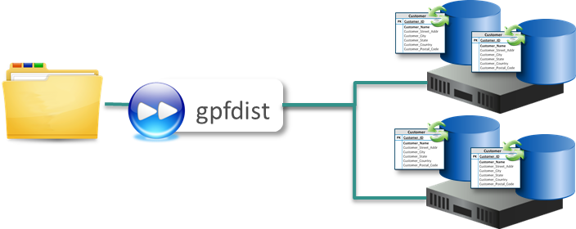
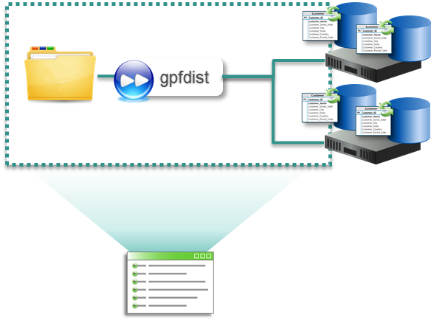
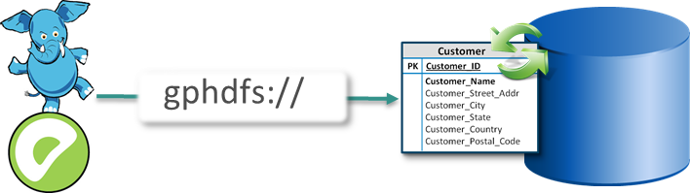
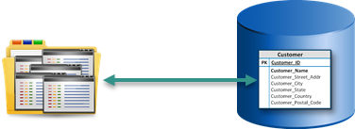
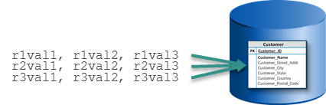
Data Loading Methods
External tables
gpfdist
gpload
gphdfs
SQL COPY
SQL INSERT
Notes:
Greenplum supports various methods for loading data into Greenplum Database. These include:
External tables for data loading and unloading.
The gpfdist utility that is used in conjunction with external tables for parallel loads and unloads.
The gpload utility which acts as an interface to the external table parallel loading feature.
The gphdfs protocol, for parallel access to data stored within the Hadoop Distributed Filesytsem (HDFS).
The COPY command to efficiently load or unload small data sets directly through the GPDB master
The use of the SQL INSERT command to insert data into tables.

Slide 3


COPY SQL Command
The COPY SQL command:
Is a PostgreSQL command
Loads all rows in one command and is not parallel
Loads data from a file or from standard input
Supports error handling similar to external tables
The following is an example of the command:
Example: Copy data from /data/myfile.csv into the table specified
COPY mytable FROM '/data/myfile.csv' WITH CSV HEADER;
Notes:
The COPY command:
Is a PostgreSQL command that loads multiple rows in one command, instead of using a series of INSERT commands.
Is optimized for loading large numbers of rows.
Is less flexible than INSERT, but incurs significantly less overhead for large data loads. Since COPY is a single command, there is no need to disable autocommit if you use this method to populate a table.
It loads data from a file or from standard output.
Supports error handling.
The table must already exist before copying to the table.

Slide 4
Loading with External Tables
Read-only external tables:
Leverage parallel processing power of segments
Can be accessed with SELECT statements
Access data outside of the Greenplum Database
Commonly used for ETL and data loading
Notes:
External tables utilize the parallel processing power of the segments for data loading.
Unlike other loading mechanisms, you can access multiple data sources with one SELECT from an external table.
The data resides outside of the Greenplum Database.
There is a lot of flexibility when defining an external table as to where, how, and what data will be used.
External tables are commonly used for ETL and data loading into the Greenplum Database.
As the demo showed, the load rate using the combination of gpfdist with an external table was about 500 times the load rate using single row inserts

Slide 5
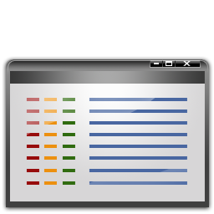



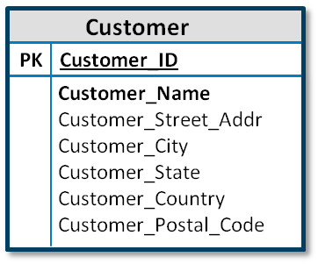


External Table Types
Data Sources and Protocols
file:// (READ ONLY)
gpfdist://
Regular source (Text, CSV, XML data)
Greenplum Database
Data Loading
URL://
Readable external table
Execute
Web source (URL or OS command)
Greenplum Database
gphdfs://
HDFS (Text, Custom data)
Data Unloading
Writable external table
Notes:
Regular external tables:
Access static data and is rescannable.
Uses the file:// or gpfdist:// protocols. gpfdist is a file server program that serves files in parallel.
Web tables use the http:// protocol or EXECUTE clause to execute an operating system command or script. Data is assumed to be dynamic, meaning that query plans involving web tables do not allow rescanning as the data could change during the course of query execution. This can yield slower query plans as the data must be materialized to disk if cannot fit in memory.
Access HDFS data using the gphdfs protocol. Data can be text or a user-defined format.
Note that, for data unloading, you can not use the file:// protocol.

Slide 6
File-Based External Tables
When creating file-based external tables:
Specify up to as many URIs as you have segments in the LOCATION clause
Each URI points to an external data file or data source
URIs do not need to exist prior to defining the external table
The URI must exist when the data is queried
Notes:
File-based external tables allow you to access flat files as if they were database tables.
When defining file-based external tables:
You can specify multiple external data sources or URIs (uniform resource identifiers) with the LOCATION clause, up to the number of primary segment instances in your Greenplum Database array.
Each URI points to an external data file or data source.
The URIs do not need to exist prior to defining an external table.
The CREATE EXTERNAL TABLE command does not validate the URIs specified. You will get an error if the URI cannot be found when querying the external table.

Slide 7
File-Based External Table Protocol and Format
Example: Create an external table with multiple URIs
CREATE EXTERNAL TABLE ext_expenses (name text, date date, amount float4, category text, description text)
LOCATION (
'file://seghost1/dbfast/external/expenses1.csv',
'file://seghost1/dbfast/external/expenses2.csv',
'file://seghost2/dbfast/external/expenses3.csv',
'file://seghost2/dbfast/external/expenses4.csv',
'file://seghost3/dbfast/external/expenses5.csv',
'file://seghost3/dbfast/external/expenses6.csv',
)
FORMAT 'CSV' ( HEADER );
You can define as many URIs as you have segments
Protocol can be file, gpfdist, gpfdists, or gphdfs
Format can be CSV, TEXT, XML, or custom
Notes:
You may use only one of the following protocols for each external table you define – they can’t be mixed:
gpfdist:// , gpfdists://, gphdfs://
file:// — If using the file:// protocol, the external data file or files must reside on a segment host in a location accessible by the Greenplum super user. On a system with 8 primary segments, and you specify only 2 external files, you end up utilizing only ¼ of your segments at query time, so performance won’t be as good as if you’d defined 8 external files, one per primary segment.

Slide 8
Parallel File Distribution Program
The parallel file distribution program, gpfdist:
Is a C program that uses HTTP
Can be run on an external server
Distributes data at 200 MB/s per gpfdist
Provides full parallelism for best performance
The data load utility, gpload:
Interfaces with and invokes gpfdist
Creates an external table definition
Executes INSERT, UPDATE, or MERGE to load data
Notes:
The parallel file distribution program, gpfdist:
Is a C program which uses the HTTP protocol.
Can be run on a server outside the Greenplum array.
Distributes data at a rate of 200 MB/s per gpfdist executing on the system.
Degree of parallelism be configured with the parameter: gp_external_max_segs.
Provides full parallelism for the best performance.
gpload is a data loading utility that acts as an interface to Greenplum’s external table parallel loading feature. Using a load specification defined in a YAML formatted control file, gpload executes a load by:
Invoking the Greenplum parallel file server program.
Creating an external table definition based on the source data defined.
Executing an INSERT, UPDATE or MERGE operation to load the source data into the target table in the database.

Slide 9
Parallel File Distribution Program Example
gpfdist -d /var/load_files/expenses1 -p 8081 >> gpfdist.log 2>&1 & gpfdist -d /var/load_files/expenses2 -p 8082 >> gpfdist.log 2>&1 &
gpfdist is started with the following syntax:
Example: Creating an external table using the gpfdist protocol
CREATE EXTERNAL TABLE ext_expenses (name text, date date, amount float4, description text) LOCATION ( 'gpfdist://etlhost:8081/*', 'gpfdist://etlhost:8082/*') FORMAT 'TEXT' (DELIMITER '|')
ENCODING ’UTF-8’
LOG ERRORS INTO ext_expenses_loaderrors
SEGMENT REJECT LIMIT 10000 ROWS ;
Notes:
In the example shown here, the parallel file distribution program is started and points to the directory, /var/load_files/expenses. Each instance opens a unique port number: port 8081 in the first example and port 8082 in the second.
The external table that is created connects to the parallel file distribution programs started on ports 8081 and 8082 of the server.
Running two gfdist processes per file system, and one per network interface (NIC), is recommended.

Slide 10
Parallel File Distribution Program Example (Cont’d.)
Example: Load data into a regular table
INSERT INTO expenses (SELECT * FROM ext_expenses);
Notes:
Here’s the common idiom for triggering the load from the external table.

Slide 11
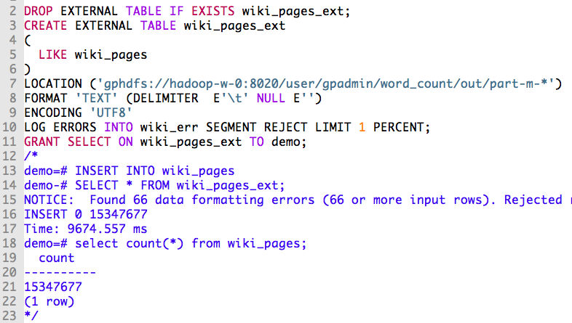
Accessing Hadoop Data Using gphdfs
Notes:
Here’s an example of using the “gphdfs” protocol to load the entire Wikipedia dump into GPDB.
First, a MapReduce job was run against the bzipped XML dump file, to dump a tab-delimited version, one page per line, containing the page ID,
Title, timestamp, and the full text of the page.
This external table’s LOCATION clause uses a wildcard ‘*’ to point to all of the mapper output files (this was a map-only job).
The encoding is explicitly set to “UTF8”, and error handling has been configured.
There were 66 data formatting errors but, since that was well below the threshold of one percent, the load succeeded.
The entire load of Wikipedia took about ten seconds, because all 64 segments of this GPDB cluster were able to indpendently access the data in HDFS
And load it in parallel.

Slide 12
Accessing Hadoop Data Using gphdfs (Cont’d.)
One time setup for using gphdfs requires setting
a couple of configuration parameters:
gp_hadoop_target_version -- corresponds with the version of Hadoop you’re using
gp_hadoop_home -- points to your Hadoop client
installation directory
Notes:
Further detail on these parameters is available on gpdb.docs.pivotal.io, and you should be able to find it by searching for “GPDB One-time HDFS Protocol Installation”
Using a web search engine.

Slide 13
gpload YAML Control File Example
Example: YAML Control File for Loading Data
VERSION: 1.0.0.1
DATABASE: faa2
USER: gpadmin
HOST: smdw
PORT: 5432
GPLOAD:
INPUT:
- SOURCE:
LOCAL_HOSTNAME:
- mdw
PORT: 8081
FILE:
- /rawdata/FAAData/On_Time_On_Time_Performance_*.csv
- FORMAT: csv
- DELIMITER: ','
- ESCAPE: '"'
- QUOTE: '"'
- HEADER: true
- ERROR_LIMIT: 100
- ERROR_TABLE: faadata.faadataerr
OUTPUT:
- TABLE: faadata.factontimeperformance
- MODE: insert
PRELOAD:
- TRUNCATE: true
- REUSE_TABLES: false
SQL:
- BEFORE: "INSERT INTO audit VALUES('start', current_timestamp)"
- AFTER: "INSERT INTO audit VALUES('end', current_timestamp)"
Greenplum Database connection information
gpload definition block
Indentation spaces, not tabs, determine hierarchy
gpfdist configuration information
Pre-existing table and data entry mode
Preloading data section
Pre and post SQL statements
Notes:
In this example, the YAML control file, load_faadata.yaml, defines how data from several source files is to be loaded into the faa2 database. It is assumed that the faadata.factontimeperformance and public.audit tables already exist within the database. A reject limit of 100 errors is defined for this load, with any errors redirected to the faadata.faadataerr table.
Before the load occurs, the table is truncated. The external table created as a result of this load will not be reused. Reusing a table is useful if you are performing trickle loads or need to reduce system catalog bloat, which can occur when creating and dropping multiple temporary tables. By reusing the table, the table is not destroyed and recreated.

Slide 14
gpload Syntax
The gpload syntax is as follows: gpload -f control_file [-l log_file] [-h hostname] [-p port] [-U username] [-d database] [-W] [-v | -V] [-q] [-D] gpload -? | --version
The following is an example of how it is used:
Example: Successful data load with gpload
$ gpload -f load_faadata.yaml
2012-01-17 09:05:29|INFO|gpload session started 2012-01-17 09:05:29
2012-01-17 09:05:29|INFO|started gpfdist -p 8081 -P 8082 -f "/rawdata/FAADOn_Time_Performance_*.csv" -t 30
2012-01-17 09:11:23|INFO|running time: 353.36 seconds
2012-01-17 09:11:23|INFO|rows Inserted = 20860045
2012-01-17 09:11:23|INFO|rows Updated = 0
2012-01-17 09:11:23|INFO|data formatting errors = 0
2012-01-17 09:11:23|INFO|gpload succeeded
$
Notes:
The gpload utility is executed with the following syntax:
gpload –f control_name
The command will display the gpfdist command that was issued.
Once the external table has been created, data is automatically loaded into the target database table specified in the control file.
gpload display the number of rows inserted, updated, as well as the number of errors encountered.
If the user is not specified on the command line, with the “-U” option, gpload will extract the user from one of the following in the order shown: the load control file, the environment variable $PGUSER or the login of the user running the command.
As with the user, if the password is not specified on the command line, gpload will extract the password from the following in the order specified: $PGPASSWORD variable, the password file specified by $PGPASSFILE or ~/.pgpass; if none of these contain the password, you will be prompted.

Slide 15
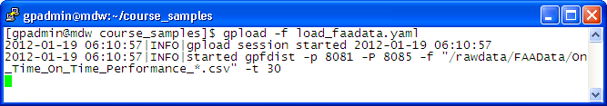
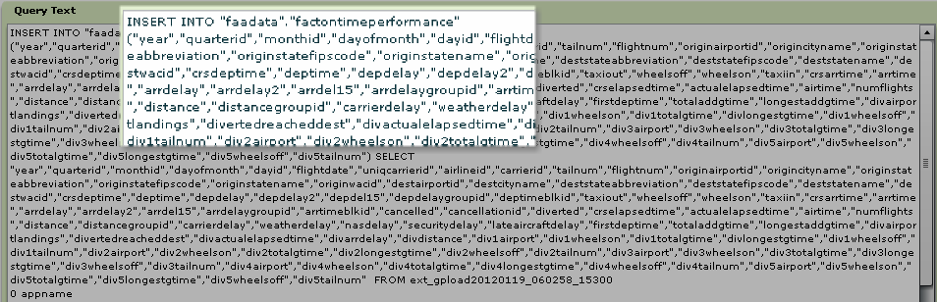
Loading Data with gpload
Example: Load data with gpload
$ gpload –f load_faadata.yaml
gpload starts gpfdist
Data is loaded into target table
Notes:
Once the control file has been created, issuing the gpload command starts a chain of events:
The gpfdist program is started.
gpload creates the external table based on the YAML file.
The data is loaded using INSERT, as specified in the YAML file.

Slide 16
External Web Table Protocols and Format
Example: External WEB table with data loads from URLs
CREATE EXTERNAL WEB TABLE ext_expenses (name text, date date, amount float4, description text)
LOCATION ( 'http://intranet.company.com/expenses/sales/expenses.csv', 'http://intranet.company.com/expenses/finance/expenses.csv',
'http://intranet.company.com/expenses/ops/expenses.csv')
FORMAT 'CSV' ( HEADER );
Example: External WEB table with data loads from a script
CREATE EXTERNAL WEB TABLE log_output (linenum int, message text) EXECUTE '/var/load_scripts/get_log_data.sh' ON HOST FORMAT 'TEXT' (DELIMITER '|');
Notes:
In the first example shown on the slide, an external web table is defined using the HTTP protocol. Three different URLs are associated with the external table, all using the CSV format.
The second example shows how to define an external table to a script. The script:
Must be located on all segments in the same location.
Must be executable by the superuser account.
Will execute by one segment on each segment host.
Executes in parallel on all segments.

Slide 17
External Web Table Protocols and Format (Cont’d.)
Example: External WEB table with data loads from a command
CREATE EXTERNAL WEB TABLE du_space (storage text) EXECUTE 'df -k' ON ALL FORMAT 'TEXT';
Notes:
In the third example, the external table is created on the command, df -k. The command is executed by each primary segment.

Slide 18


Environment Variables for Command-Based Web Tables
Are not sourced at the segment host
Can be set in the EXECUTE clause as follows:
Example: External WEB table with environment variables
CREATE EXTERNAL WEB TABLE TEST(segname text, abbrev text) EXECUTE 'export HNAME="$HOSTNAME"-SR; echo "$HOSTNAME,$HNAME"' FORMAT 'TEXT' (DELIMITER ',');
SELECT * FROM test; segname | abbrev
---------+---------
sdw2 | sdw2-SR
sdw1 | sdw1-SR
(2 rows)
Note: You can disable the use of the EXECUTE command in web table definitions by setting gp_external_enable_exec to off.
A fly and a flea in a flue
Were imprisoned, so what could they do
Said the fly, let us flee. Let us fly said the flee
So they flew through a flaw in the flue.
A canner exceedingly canny
One morning remarked to his granny
A canner can can anything that he can
But a canner can’t can a can can he?
Notes:
When an external table command is executed, that command is executed from within the database and not from a login shell. If you rely on environment variables in external web table commands, such as the $PATH variable, keep in mind that the .bashrc or .profile of the current user will not be sourced at the segment host. You can set desired environment variables from within the EXECUTE clause of your external web table definition as follows:
CREATE EXTERNAL WEB TABLE ext_table (…) EXECUTE 'export PATH=/usr/sbin‘
Note that you can disable the use of the EXECUTE command in web table definitions by setting the parameter, gp_external_enable_exec, to off in the postgresql.conf file.

Slide 19
External Table Environment Variables
Variable | Description
$GP_CID | Command count of the session executing the external table statement.
$GP_DATABASE | The database that the external table definition resides in.
$GP_DATE | The date the external table command was executed.
$GP_MASTER_HOST | The host name of the Greenplum master host from which the external table statement was dispatched.
$GP_MASTER_PORT | The port number of the Greenplum master instance from which the external table statement was dispatched.
$GP_SEG_DATADIR | The location of the data directory of the segment instance executing the external table command.
$GP_SEG_PG_CONF | The location of the postgresql.conf file of the segment instance executing the external command.
The following are variables available to the EXECUTE clause:
Notes:
The Greenplum Database variables shown in the table are available to operating system commands executed by an external table. These variables are set as environment variables in the shell that executes the external table command(s). They can be used to identify a set of requests made by an external table statement, at runtime, across the Greenplum Database array of hosts and segment instances.

Slide 20
External Table Environment Variables (cont’d.)
Variable | Description
$GP_SEG_PORT | The port number of the segment instance executing the external table command.
$GP_SEGMENT_COUNT | The total number of primary segment instances in the Greenplum Database system.
$GP_SEGMENT_ID | The ID number of the segment instance executing the external table command.
$GP_SESSION_ID | The database session identifier number associated with the external table statement.
$GP_SN | Serial number of the external table scan node in the query plan of the external table statement.
$GP_TIME | The time the external table command was executed.
$GP_USER | The database user executing the external table statement.
$GP_XID | The transaction ID of the external table statement.
Notes:
External Table EXECUTE Variables (Continued)

Slide 21
External Table Error Handling
When handling errors using external tables:
Incorrectly formatted rows are rejected:
Rows with missing or extra attributes
Rows with columns of the wrong data type
Rows with invalid client encoding sequence
CONSTRAINT errors (NOT NULL, CHECK, UNIQUE ) are handled “all or nothing” -- not single row isolation
Format of error handling clause: [LOG ERRORS] SEGMENT REJECT LIMIT count [ROWS | PERCENT]
Notes:
The most common use of external tables is to facilitate loading of data. This is typically done by issuing a CREATE TABLE AS SELECT or INSERT INTO SELECT command, where the SELECT statement triggers the flow of data.
By default, if the external table data contains an error, the entire command fails and no data is loaded into the target database table. To isolate data errors in external table data while still loading correctly formatted rows:
You define an external table with a SEGMENT REJECT LIMIT clause.
Specify the number of error rows acceptable, on a per-segment basis, after which the entire external table operation will be aborted and no rows will be processed or loaded.
Note that the count of error rows is per-segment, not per entire operation. The following conditions then apply:
If the per-segment reject limit is not reached, all rows that do not contain an error will be processed.
If the limit is not reached, all good rows will be processed and any error rows discarded.
If you would like to keep error rows for further examination, you can optionally declare an error table using the LOG ERRORS INTO clause. Any rows containing a format error would then be logged to the specified error table.

Slide 22
External Tables and Planner Statistics
Query planning of complex queries on external tables is not optimal because:
Data resides outside the database
No database statistics exist for external table data
Data from external tables are not meant for frequent or ad-hoc access
Notes:
Query planning of complex queries involving external tables is not optimal because:
There are no statistics to help the query planner choose a good plan.
The data is not in the database.
External tables are really not meant to be used in frequent, ad-hoc queries.

Slide 23
Data Loading Performance Tips
Drop indexes and recreate them after loading data
Use gpfdist to load or unload data in Greenplum Database
Spread the data evenly across as many ETL nodes as possible
Split very large data files into equal parts and spread the data across as many file systems as possible
Run two gpfdist instances per file system
Run gpfdist on as many network interfaces as possible

Slide 24
Data Loading Performance Tips (Cont’d.)
Use gp_external_max_segs to control the number of segments each gpfdist serves
Always keep gp_external_max_segs and the number of gpfdist processes an even factor
Always drop indexes before loading into existing tables and re-create the index after loading
Always run ANALYZE on the table after loading it
Disable automatic statistics collection during loading by setting gp_autostats_mode to NONE
Run VACUUM after load errors to recover space

